Slide 1
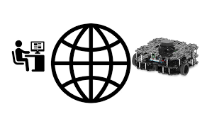
Robotics Corner IoT
ROS web tutorial part 1 - rosbridge server and roslibjs

Slide 2
In this introductory tutorial, I will guide you through the process, step by step, of utilizing the rosbridge server and roslibjs to establish communication with ROS directly from your web browser. Upon completing this tutorial, you will have successfully created a functional prototype of a basic website. This website will enable you to manipulate a robot using a virtual joystick.
Requirements
The tutorial below assumes the following tools:
ROS destor running on Ubuntu 18.04
Catkin tools

Slide 3
rosbridge_suite
Rosbridge suite is a set of packages that allows to exchange of information between ROS and any other application capable of parsing JSON.
In this tutorial we will use rosbridge on the ‘robot side’ of our robot software stack. This will allow us to exchange any information between ROS nodes and other applications (in our case an application running in the browser).

Slide 4
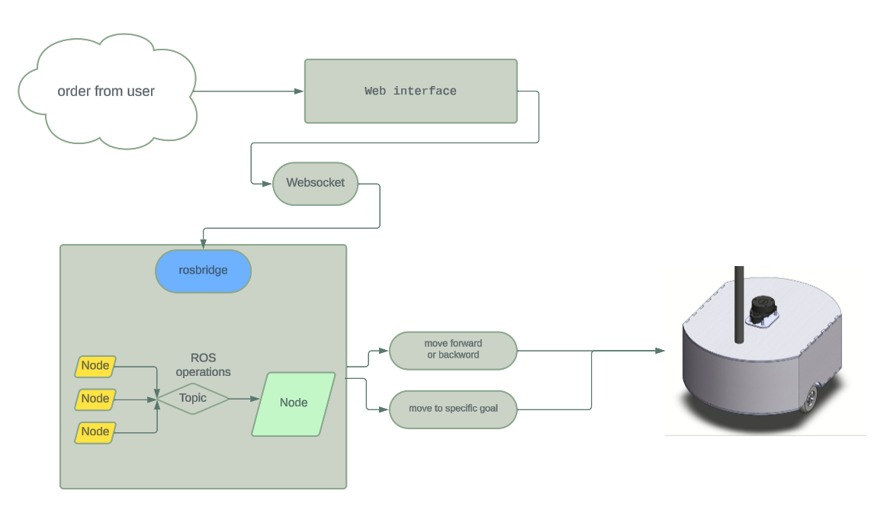

Slide 5
Setting up
mkdir -p ~/catkin_ws/src
cd ~/catkin_ws/src
catkin create pkg robot_gui_bridge --catkin-deps rosbridge_server
cd ~/catkin_ws
rosdep install --from-paths src --ignore-src -r –y
Rosbridge provides a JSON API to ROS functionality for non-ROS programs. There are a variety of front ends that interface with rosbridge, including a WebSocket server for web browsers to interact with. Rosbridge_suite is a meta-package containing rosbridge, various front-end packages for rosbridge like a WebSocket package, and helper packages.

Slide 6
In the first two lines of this shell snippet, we create a directory structure for our ROS workspace. Then we create a package called robot_gui_bridge that depends on rosbridge_server (if you are not using catkin tools you can use the command catkin_create_pkg robot_gui_bridge rosbridge_server).
In the last line of the snippet, we use rosdep to install all the required dependencies. Alternatively, you could install the package manually using the command apt-get install ros-melodic-rosbridge-server but I find using rosdep to be a better practice, especially when you collaborate with others.

Slide 7
Adding a launch file and testing
mkdir ~/catkin_ws/src/robot_gui_bridge/launch
touch ~/catkin_ws/src/robot_gui_bridge/launch/websocket.launch
The contents of this file will be very simple:
<launch>
<include file="$(find rosbridge_server)/launch/rosbridge_websocket.launch"/>
</launch>

Slide 8
Testing
cd ~/catkin_ws/
catkin build # or catkin_make
source devel/setup.bash
roslaunch robot_gui_bridge websocket.launch If everything went well the rosbridge_websocket node should start and we should see a confirmation about it running in the terminal:
[INFO] [1561100304.196110]: Rosbridge WebSocket server started on port 9090

Slide 9
roslibjs
We will start by creating a file ~/catkin_ws/src/robot_gui_bridge/gui/gui.html with the following contents:
In this link you will find the HTML code for the project: https://gist.github.com/msadowski/d5e276d9bc11a0846feda5ec0a5d8726#file-gui-html In this link there a the roslibjs file that you need: https://cdn.jsdelivr.net/npm/roslib@1/build/roslib.min.js

Slide 10
Explanation of the code
We start the script by importing a minified version of roslib from Robot Web Tools CDN.
Here we will create a Ros object that we will use to communicate with other nodes later on. We are currently running the UI and the rosbridge on the same machine, hence we are listening on localhost and the default roslib websocket port 9090.
var ros = new ROSLIB.Ros({
url : 'ws://localhost:9090'
});

Slide 11
ros.on('connection', function() {
document.getElementById("status").innerHTML = "Connected";
});
The above snippet creates a listener for the Ros event (in this case the connection event). When the event is raised we find an HTML element with a “status” id (in this case a span element that we defined in the body) and we change its inner html to the message we want to display.

Slide 12
Listening to a topic
var txt_listener = new ROSLIB.Topic({
ros : ros,
name : '/txt_msg',
messageType : 'std_msgs/String'
});
txt_listener.subscribe(function(m) {
document.getElementById("msg").innerHTML = m.data;
});
This code declares a txt_listener object that will listen to messages on /txt_msg topic and that will accept messages of type String. Then we create an event listener that will call an anonymous function that changes the inner HTML of our “msg” span element to the data field of the message.

Slide 13
To test this code follow these steps:
Launch our websocket launch file: roslaunch robot_gui_bridge websocket.launch
Open the website that we created in the browser of your choice
You should now see the text “Connected” in our connection status
In terminal publish to /txt_msg topic: rostopic pub /txt_msg std_msgs/String "data: 'Test message'" -1
The message should appear in the span field that we created for this purpose

Slide 14
Publishing on a topic
Before we implement a virtual joystick let’s create a function that we will use to publish a robot velocity:
cmd_vel_listener = new ROSLIB.Topic({
ros : ros,
name : "/cmd_vel",
messageType : 'geometry_msgs/Twist'
});
move = function (linear, angular) {
var twist = new ROSLIB.Message({
linear: {
x: linear,
y: 0,
z: 0
},
angular: {
x: 0,
y: 0,
z: angular
}
});
cmd_vel_listener.publish(twist);
}

Slide 15
Similarly when we declare our String listener we start by creating a Topic object called cmd_vel_listener and that will be publishing Twist messages on /cmd_vel topic. Afterward, we create a function called move that takes two arguments: a linear and angular speed (by ROS convention in m/s) and publish it through our cmd_vel_listener object.
rostopic echo /cmd_vel

Slide 16
Creating the Joystick
Joystick Integration:
The function createJoystick sets up a virtual joystick using the nipplejs library.
The joystick sends commands (linear_speed and angular_speed) based on the user's input, and the move function is called to publish velocity commands accordingly.
The joystick is displayed on the HTML page within the element with the ID zone_joystick.

